Slide 1

Anaphora and co-reference resolution

Slide 2
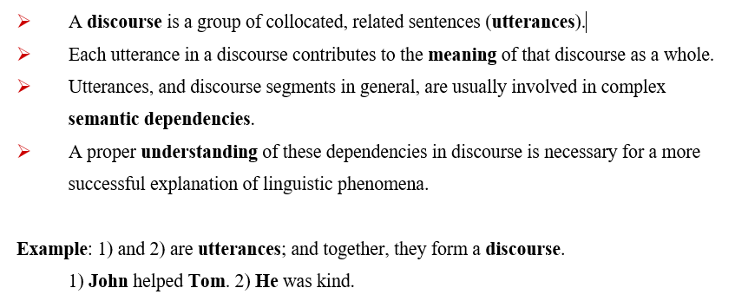
Anaphora and co-reference resolution

Slide 3
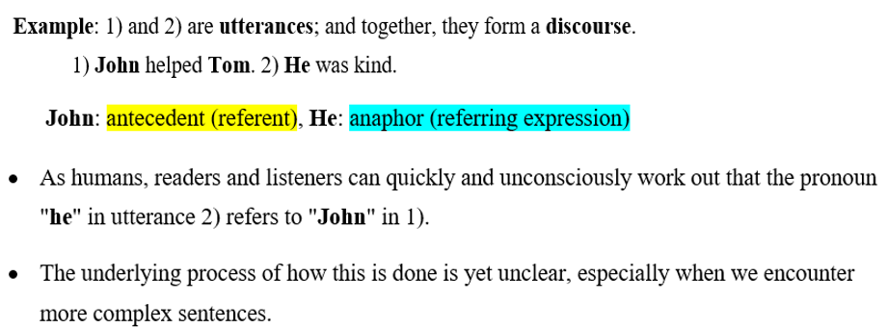

Slide 4
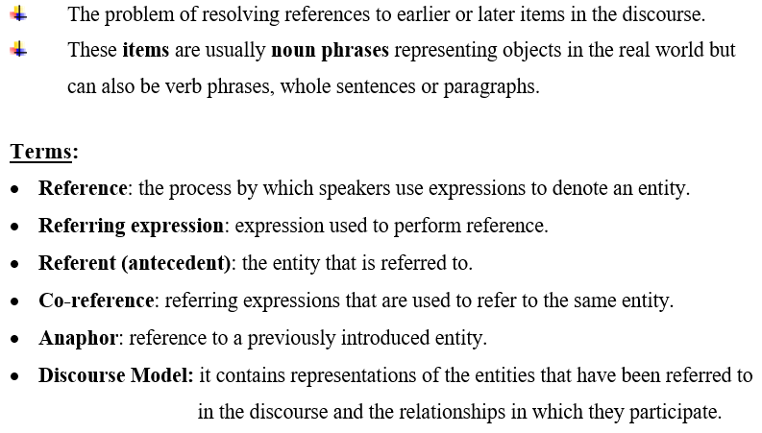
Anaphora Resolution (AR)

Slide 5
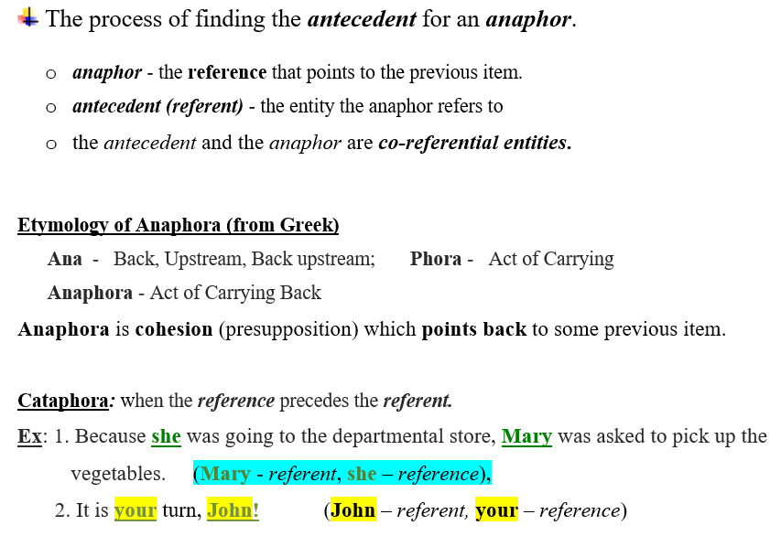
What is Anaphora Resolution?

Slide 6
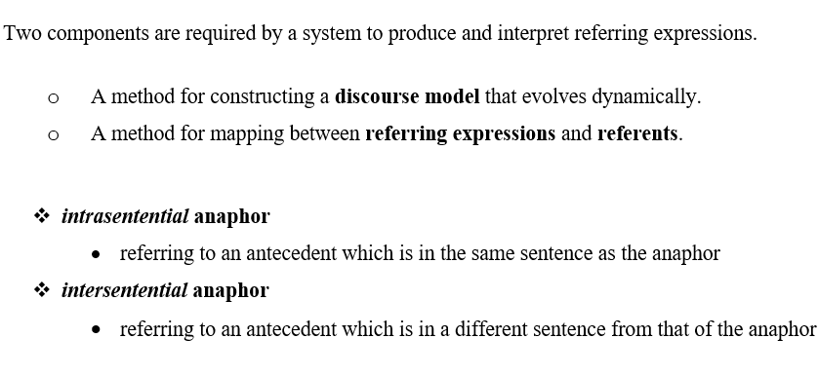

Slide 7
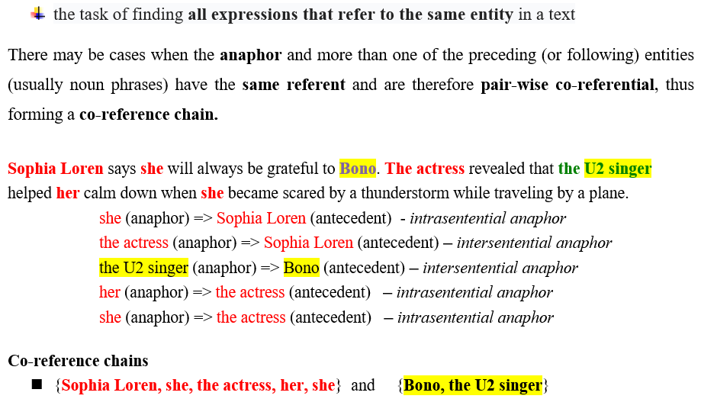
Co-reference resolution

Slide 8
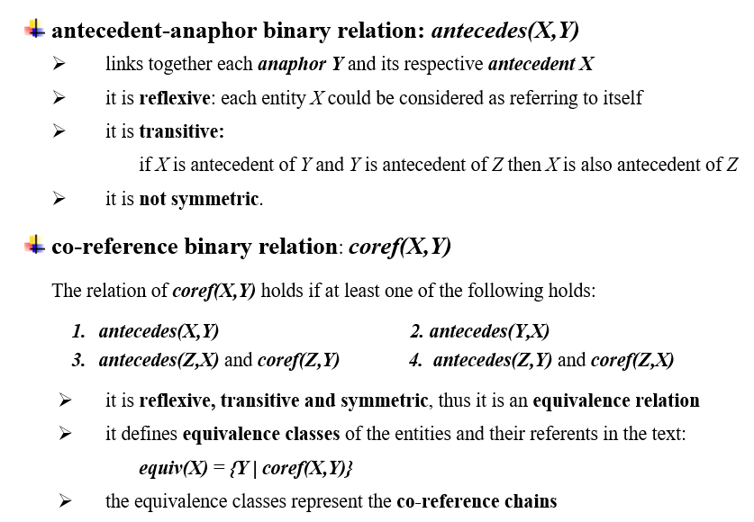
Co-reference chains – formal definition

Slide 9
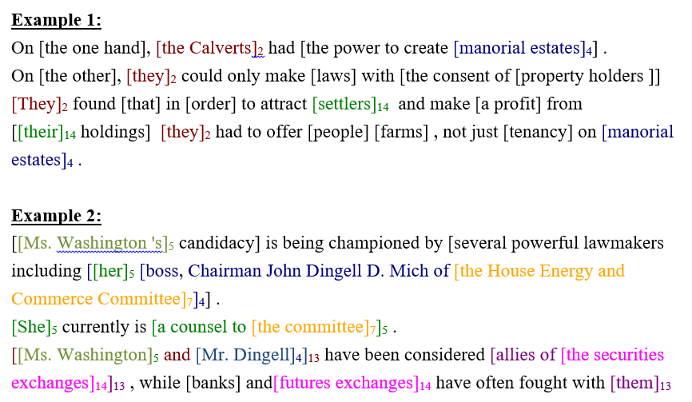
Co-reference chains

Slide 10
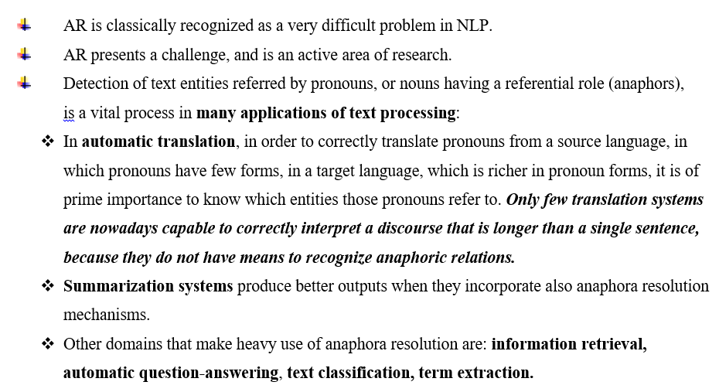
Anaphora Resolution in other NLP tasks

Slide 11
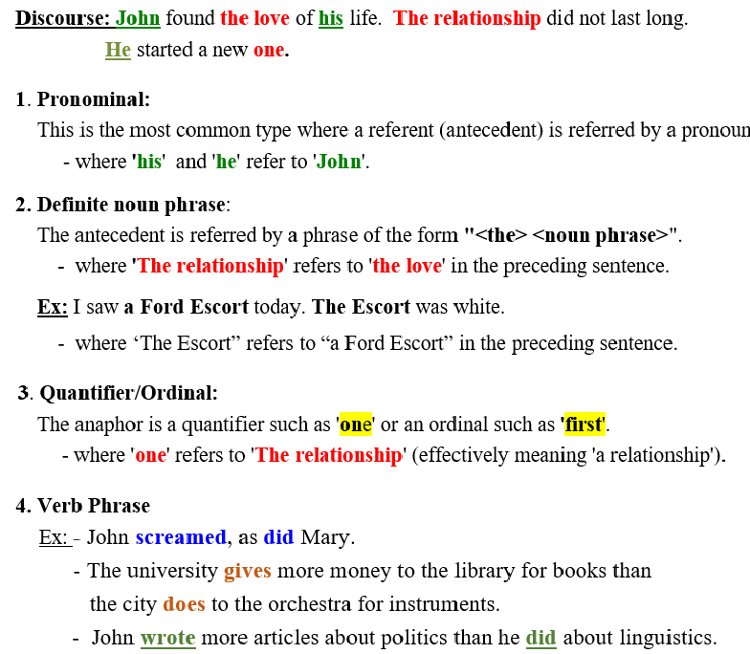
four types of anaphor

Slide 12
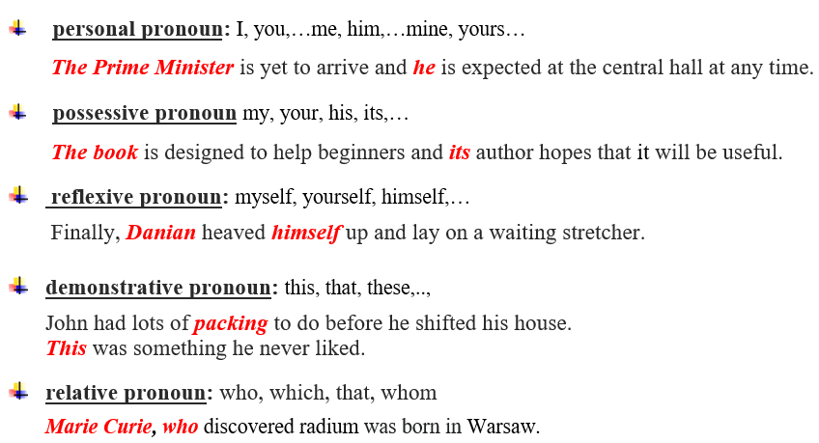
Pronominal anaphor

Slide 13
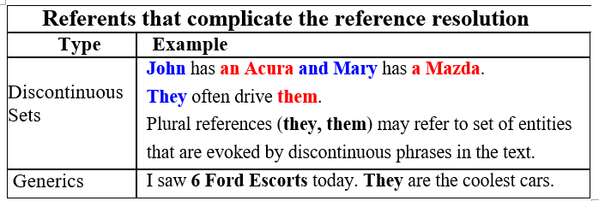
Other types of anaphor

Slide 14
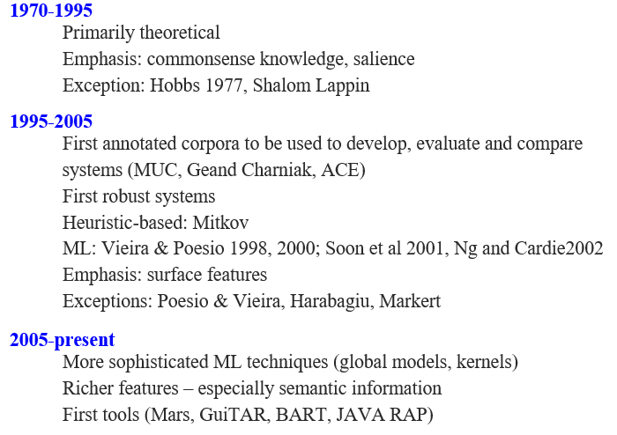
RESEARCH ON ANAPHORA RESOLUTION

Slide 15
Online Tools
https://demo.allennlp.org/coreference-resolution
https://huggingface.co/coref/

Slide 16
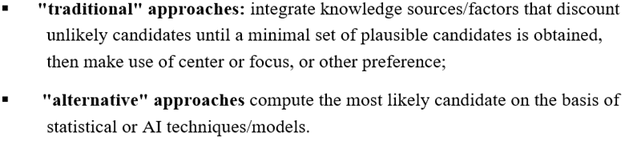
Approaches for anaphora resolution

Slide 17
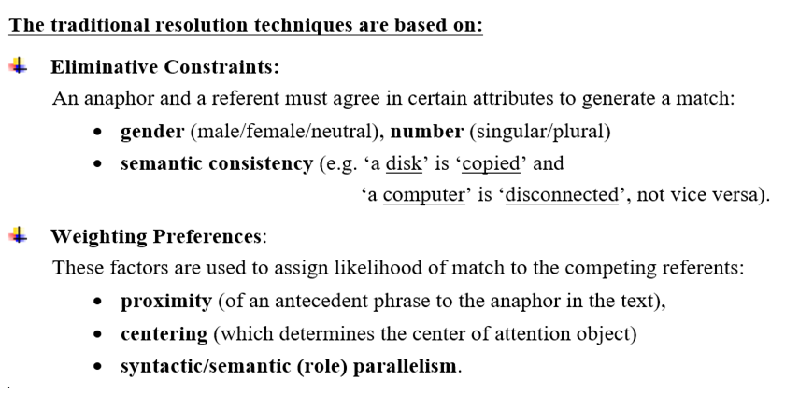

Slide 18
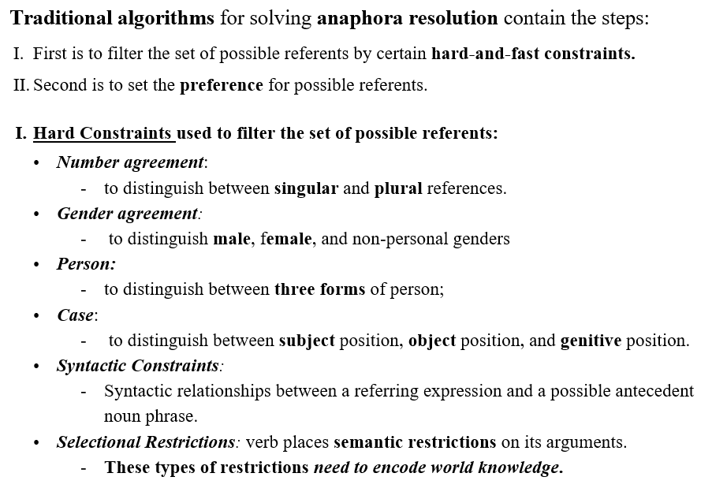

Slide 19
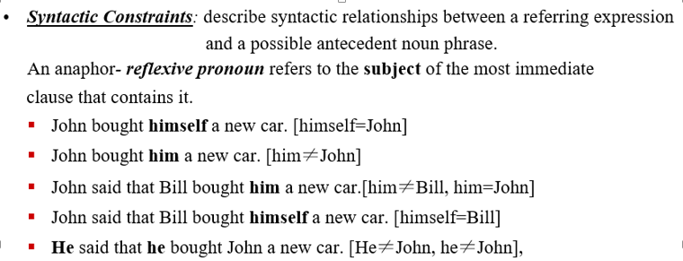
Hard Constraints

Slide 20
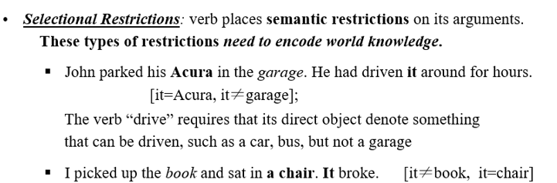
Hard Constraints

Slide 21
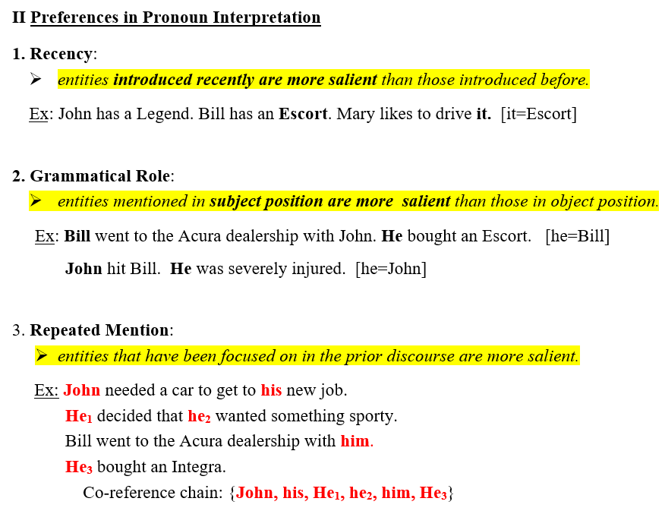
Graph-based Ranking Algorithm

Slide 22
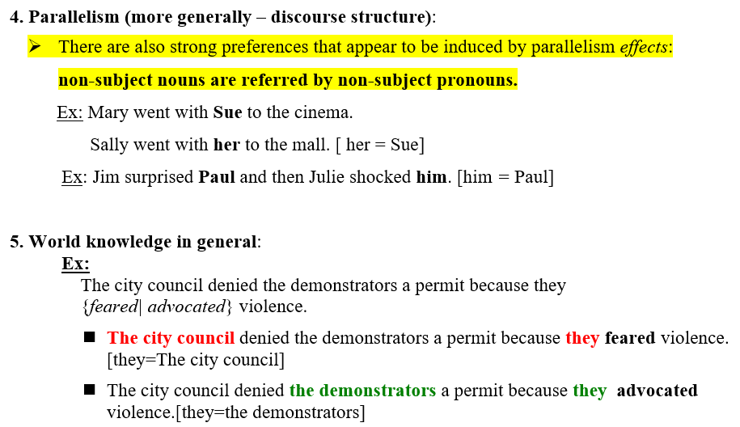
Preferences in Pronoun Interpretation (contd.)

Slide 23
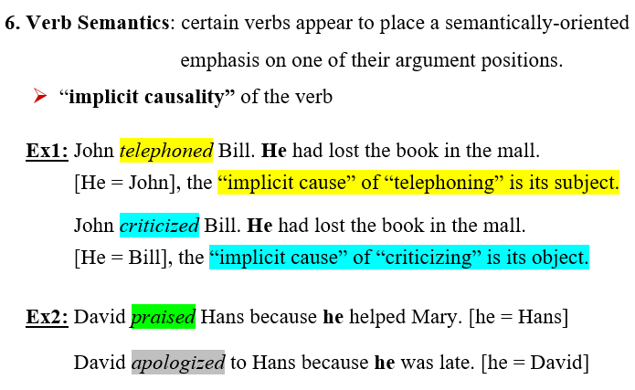
Preferences in Pronoun Interpretation (contd.)

Slide 24
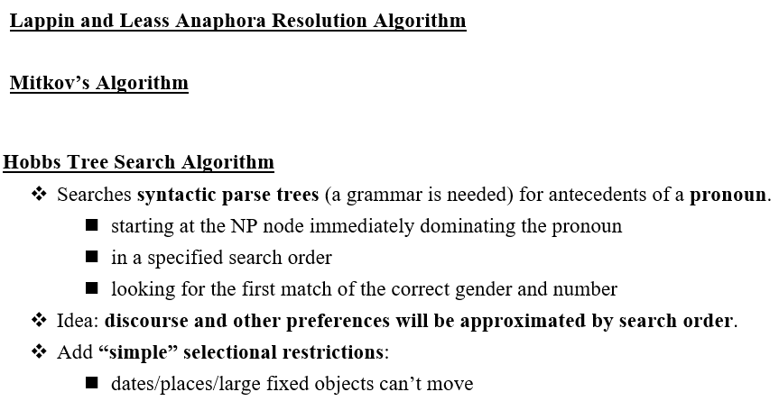
Algorithms based on traditional approaches

Slide 25
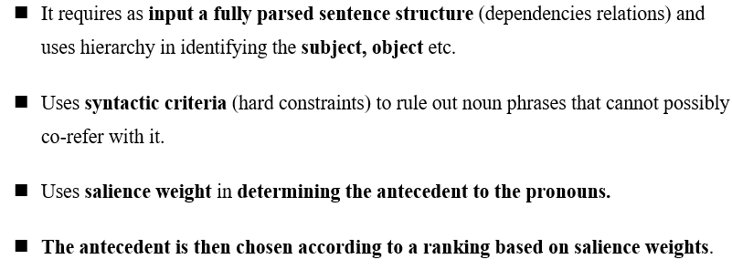
Lappin and Leass Algorithm

Slide 26
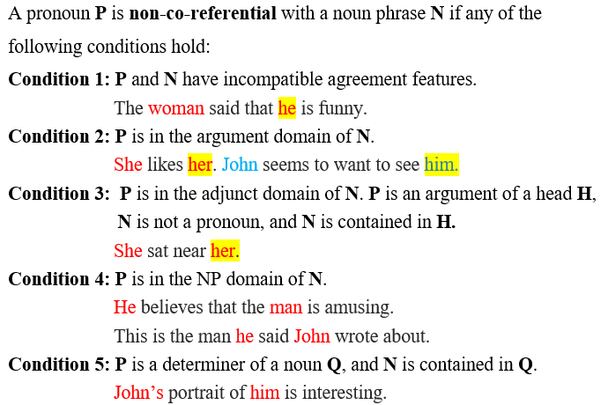
Lappin and Leass Algorithm (contd.) - syntactic criteria (hard constraints)-

Slide 27
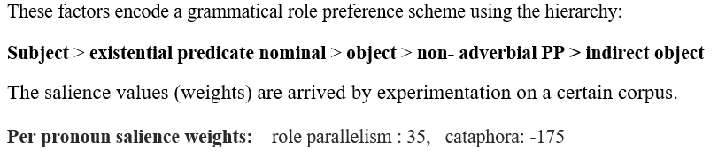
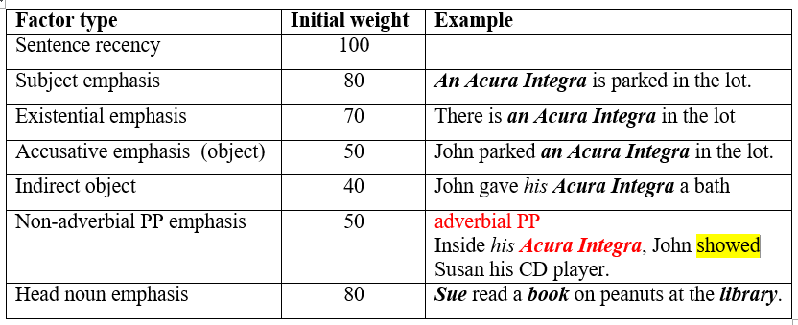
Salience factor types with initial weights

Slide 28
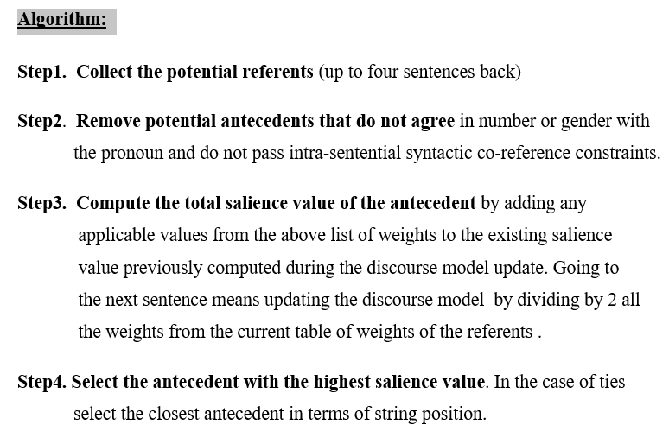

Slide 29
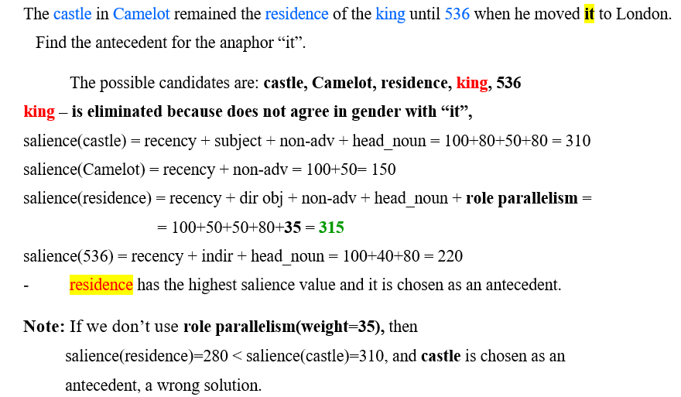
Example 1 (Lapin and Less alg.)

Slide 30
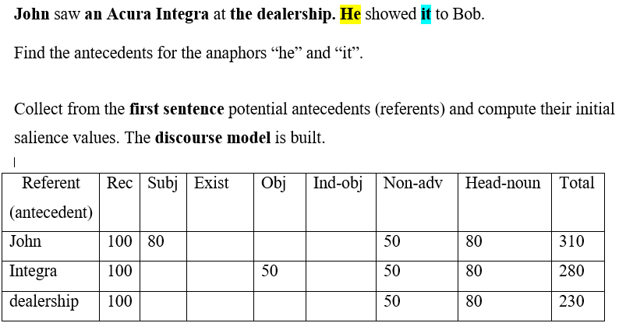
Example 2 (Lapin and Less alg.)

Slide 31
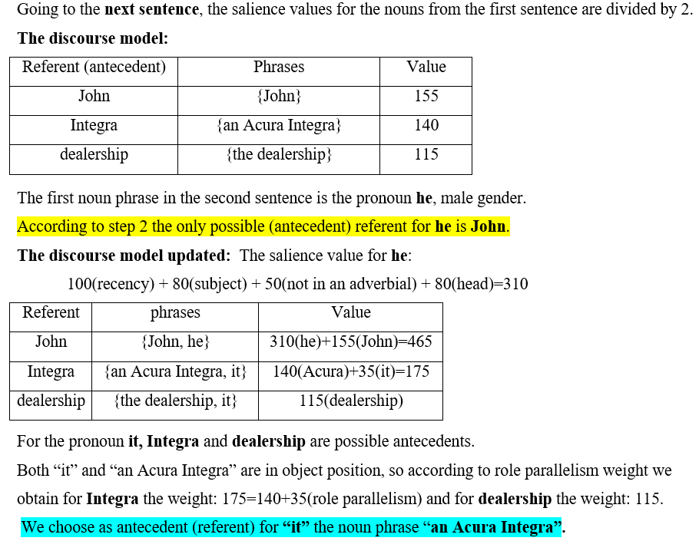
Example 2 (contd.)

Slide 32
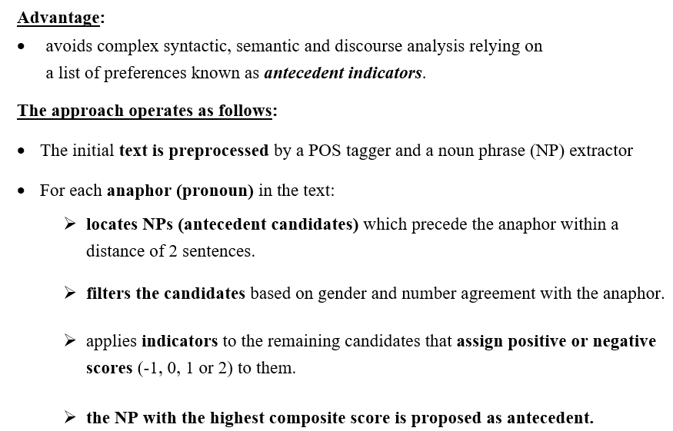
Mitkov’s Anaphora Resolution System

Slide 33
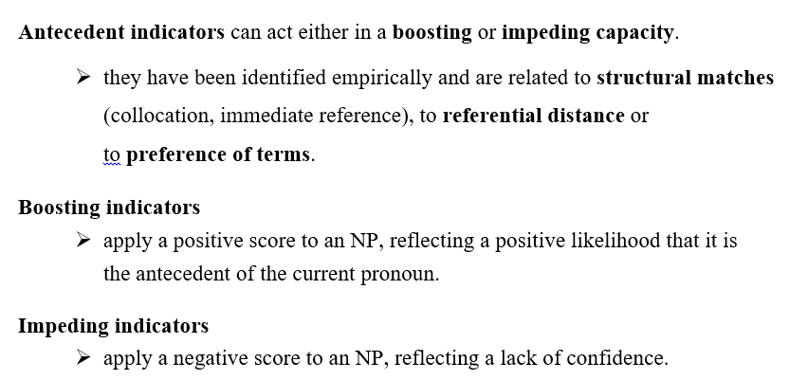

Slide 34
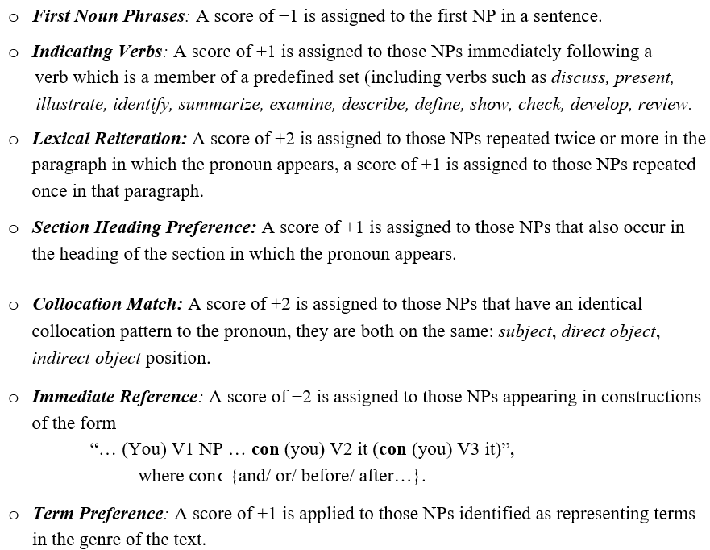
Boosting indicators

Slide 35
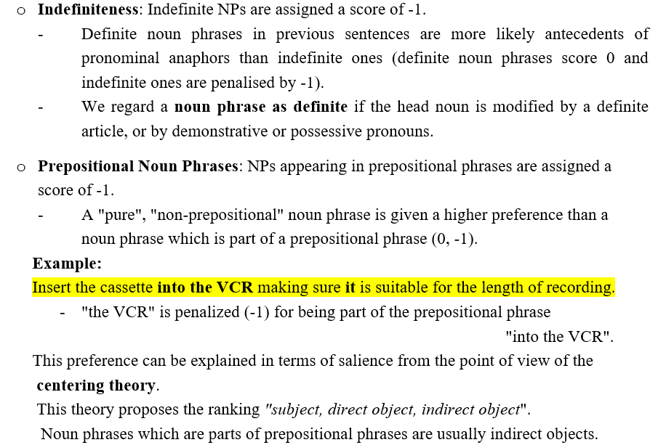
Impeding indicators

Slide 36
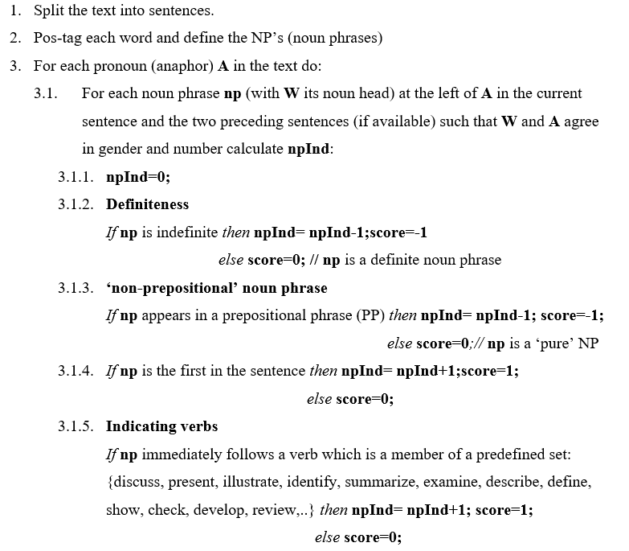
Mitkov’s algorithm step by step

Slide 37
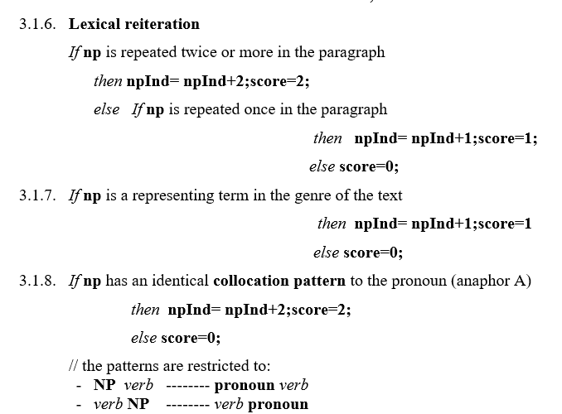
Mitkov’s algorithm step by step (contd.)

Slide 38
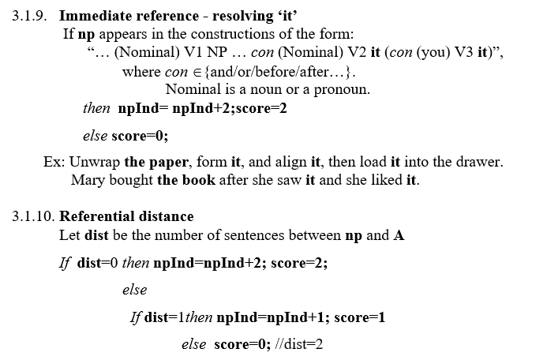
Mitkov’s algorithm step by step (contd.)

Slide 39
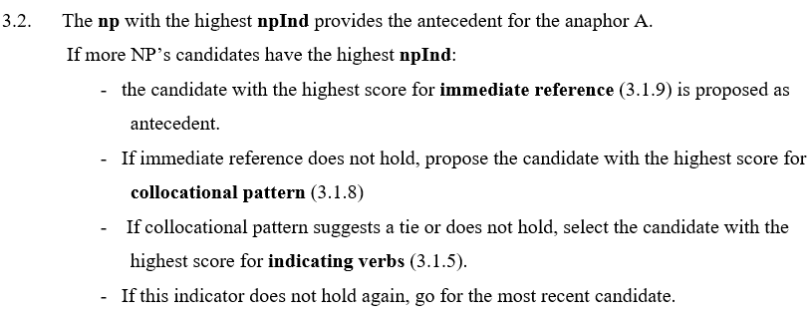
Mitkov’s algorithm step by step (contd.)

Slide 40
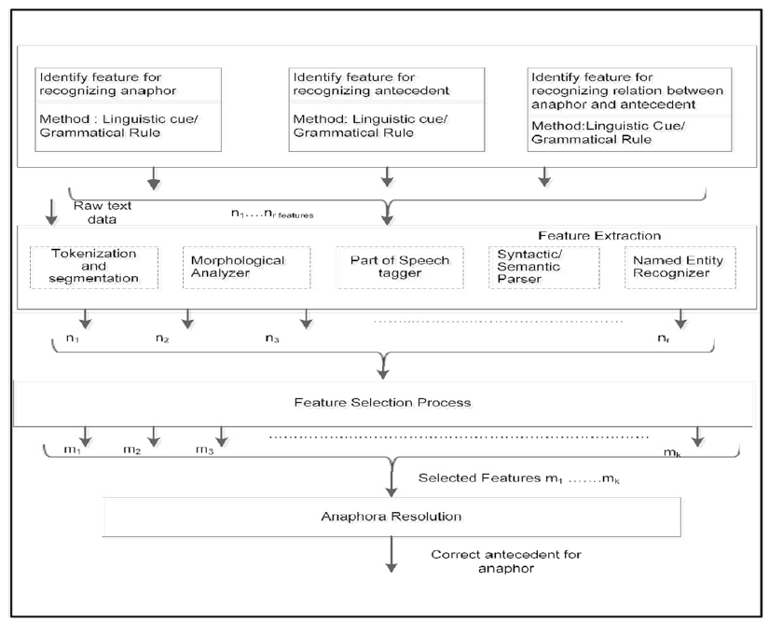
Anaphora resolution system – a machine learning approach

Slide 41
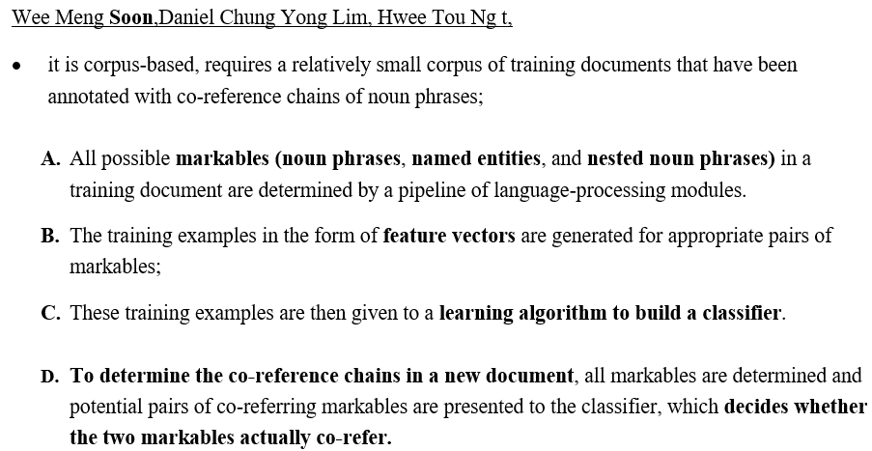
A Machine Learning Approach to Co-reference Resolution of Noun Phrases

Slide 42
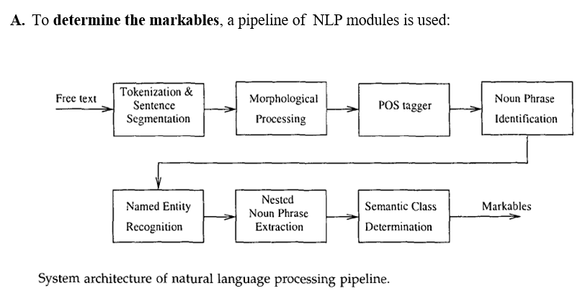

Slide 43
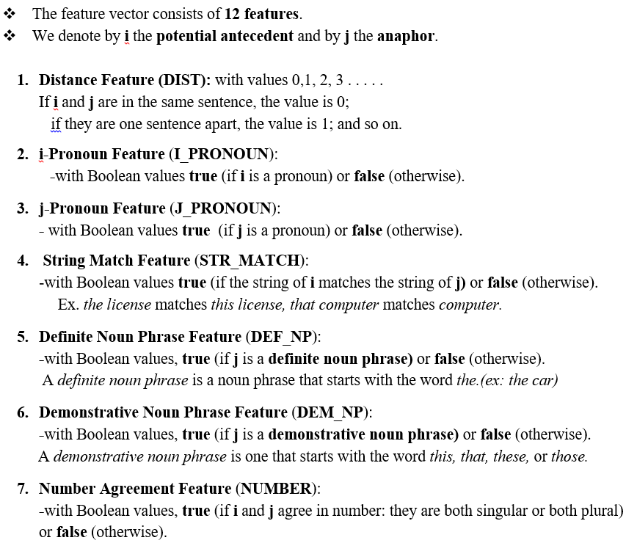
B. Determination of Feature Vectors

Slide 44
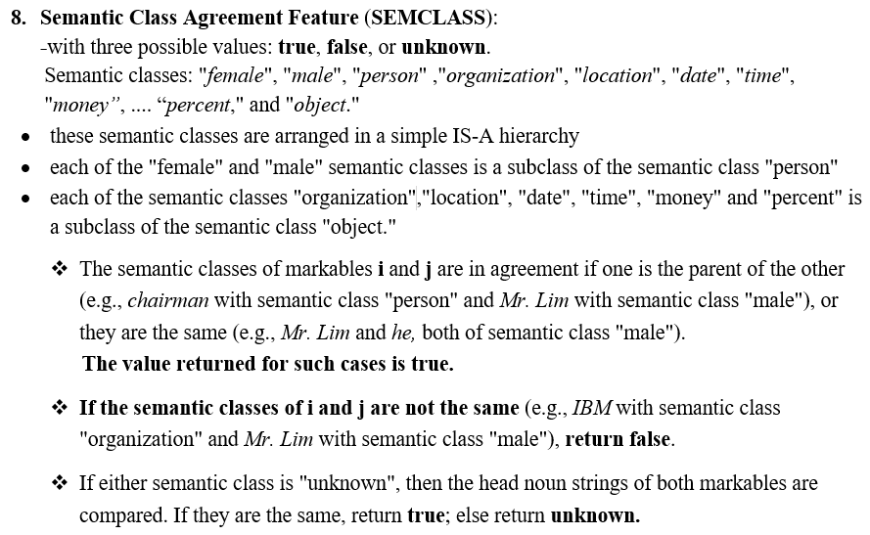
B. Determination of Feature Vectors (contd.)

Slide 45
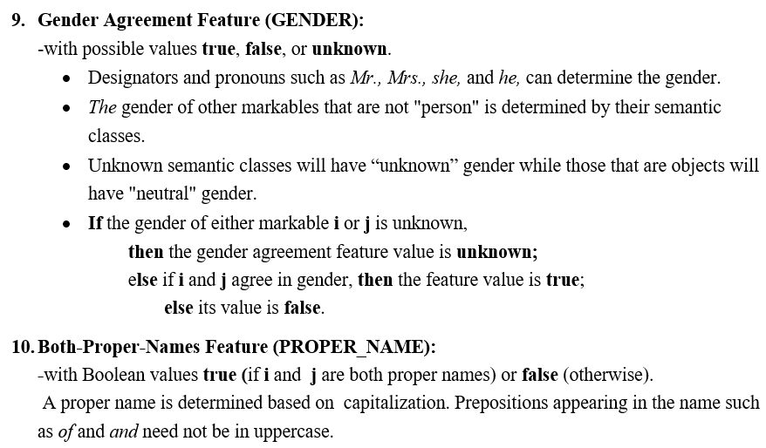
B. Determination of Feature Vectors (contd.)

Slide 46
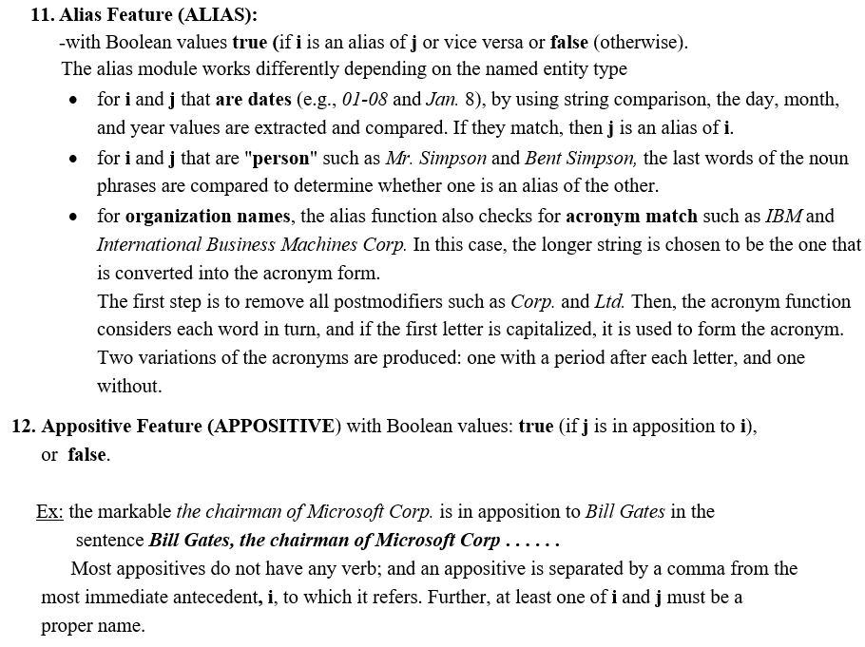

Slide 47
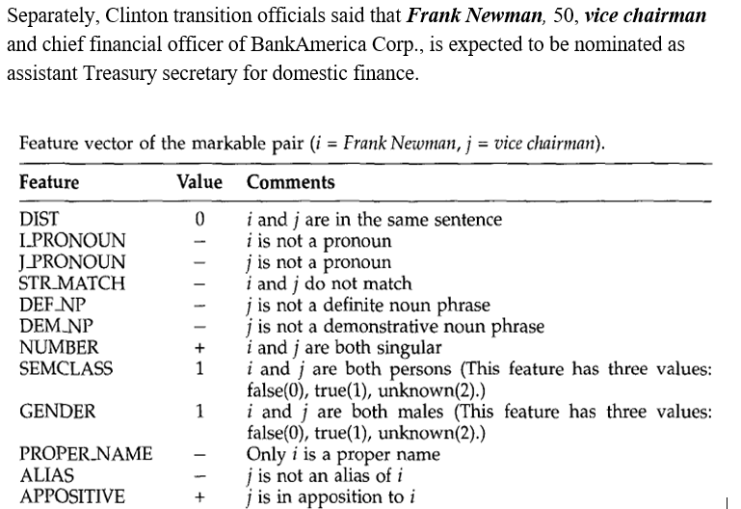
Feature vector - example

Slide 48
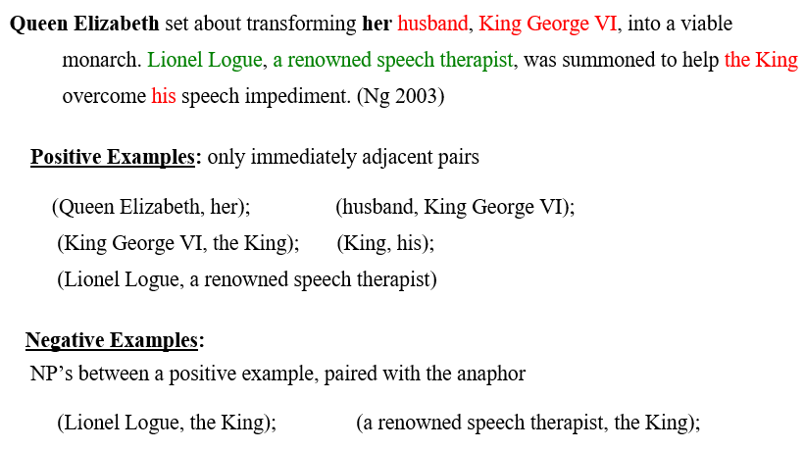
B. Generation of Training Data

Slide 49
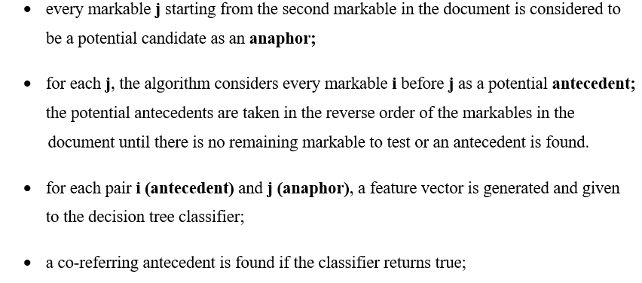
The co-reference resolution algorithm based on a decision tree classifier

Slide 50
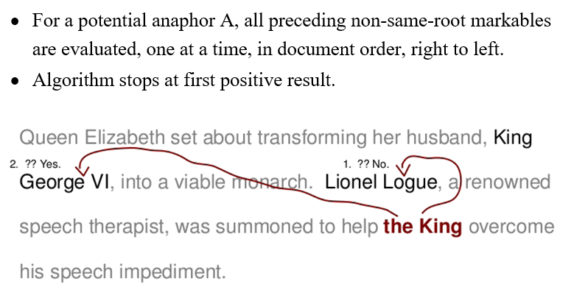
Testing method

Slide 51
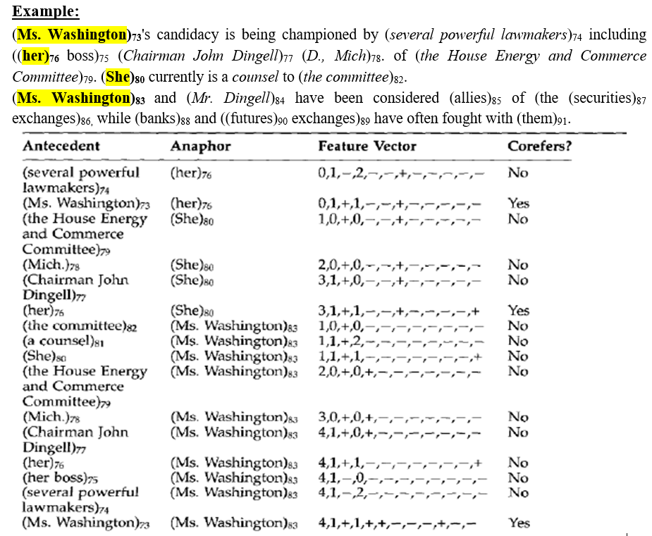

Slide 52



Slide 53


